Slide 1
CMIP7 Ozone data
Linlin Chen
2026.02

Slide 2
CMIP7 ozone forcing
Two monthly datasets:
piControl (FZJ-CMIP-ozone-1-2)
climatology: 185001-185012; remove QBO signal;
transient: 192901-184912; include nudged QBO signal;
2. historical transient (FZJ-CMIP-ozone-2-0)
185001-202212; include QBO signal
Some errors with old version 1-2, so updated with version 2-0
Data description: https://input4mips-cvs.readthedocs.io/en/latest/dataset-overviews/ozone/
Download data from:
FZJ-CMIP-ozone-1-2 (https://esgf-node.ornl.gov/search?project=input4MIPs&versionType=all&activeFacets=%7B%22source_id%22%3A%22FZJ-CMIP-ozone-1-2%22%7D ): for piControl climatology and transient.
FZJ-CMIP-ozone-2-0 (https://esgf-node.ornl.gov/search?project=input4MIPs&versionType=all&activeFacets=%7B%22source_id%22%3A%22FZJ-CMIP-ozone-2-0%22%7D ): for historical transient.

Slide 3
Data conversion
Original format: vmro3(time, plev=66, lat=96, lon=144) # vmro3: mixing ratio; mol mol -1
(month, hPa,1.875°, 2.5°)
Step1: regrid to N48 resolution
shell
cdo -selname,vmro3 -remapbil,grid_73x96.txt input.nc output_73x96.nc # (time,plev=66,lat=73,lon=96)
Step2: convert to hybrid levels
NCL
vmro3_hyb = pres2hybrid_Wrap(plev, ps, p0, o3, A, B, intflg) ; (time,hybrid_eta_x1000=19,lat=73,lon=96)
pressures are computed using: `p(k) = A(k)*P0 + B(k)*PS`
ps: surface pressure
p0: 1000hPa
A (AP), B: model dependent parameters.
intflg =1, values set to nearest valid value
Step3: calculate zonal mean
NCL
O3 = dim_avg_n_Wrap(vmro3_hyb, 3) ; (time,hybrid_eta_x1000=19,lat=73)
Notes:
grid_73x96.txt: lat=90, …; lon=0, 3.75, …

Slide 4
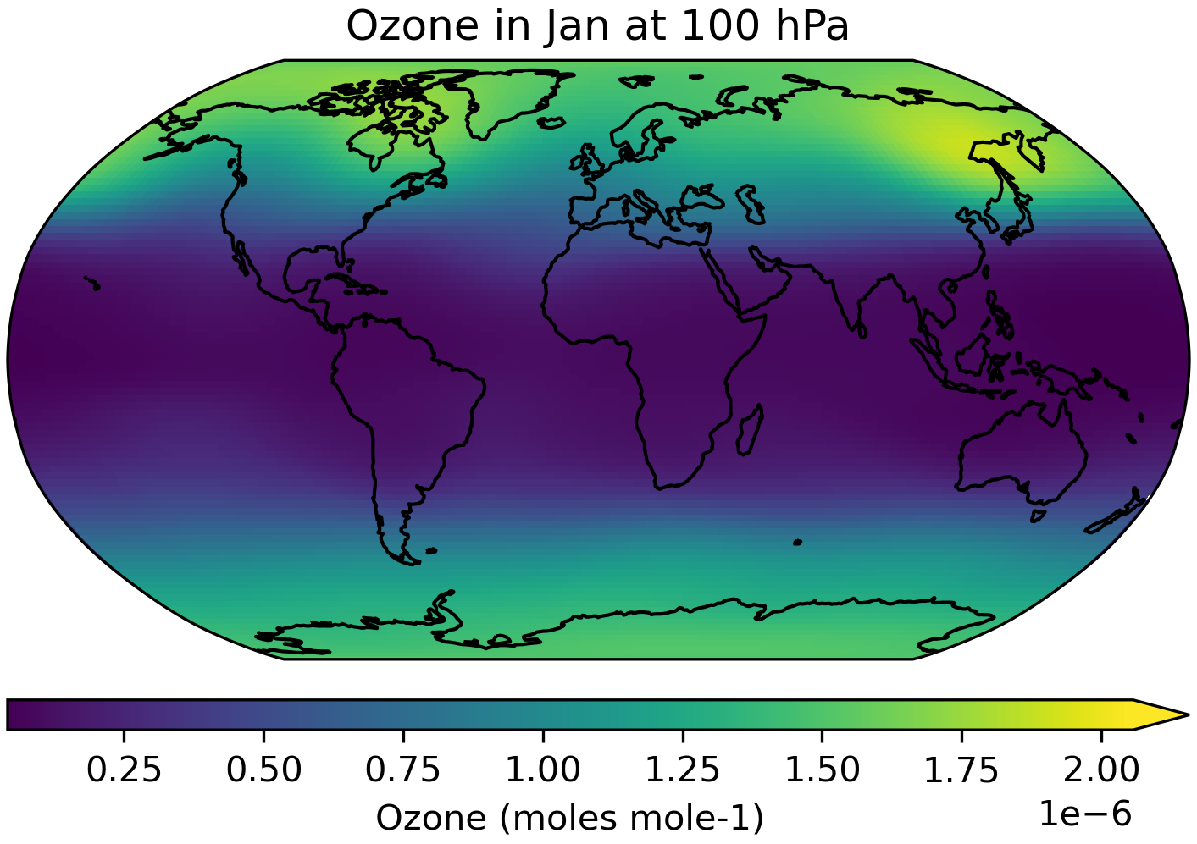
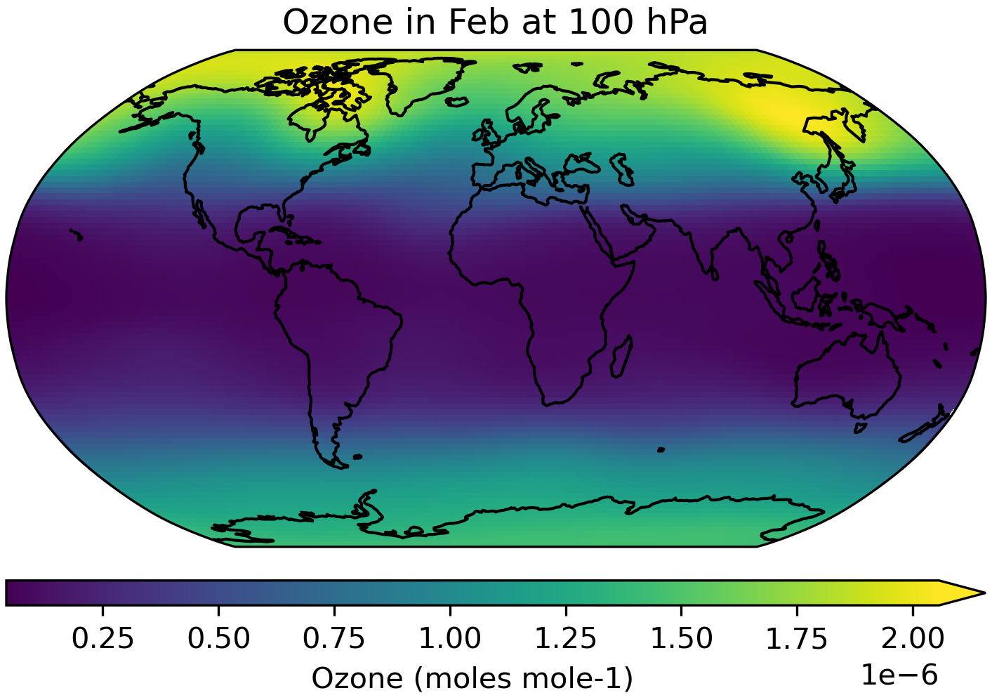
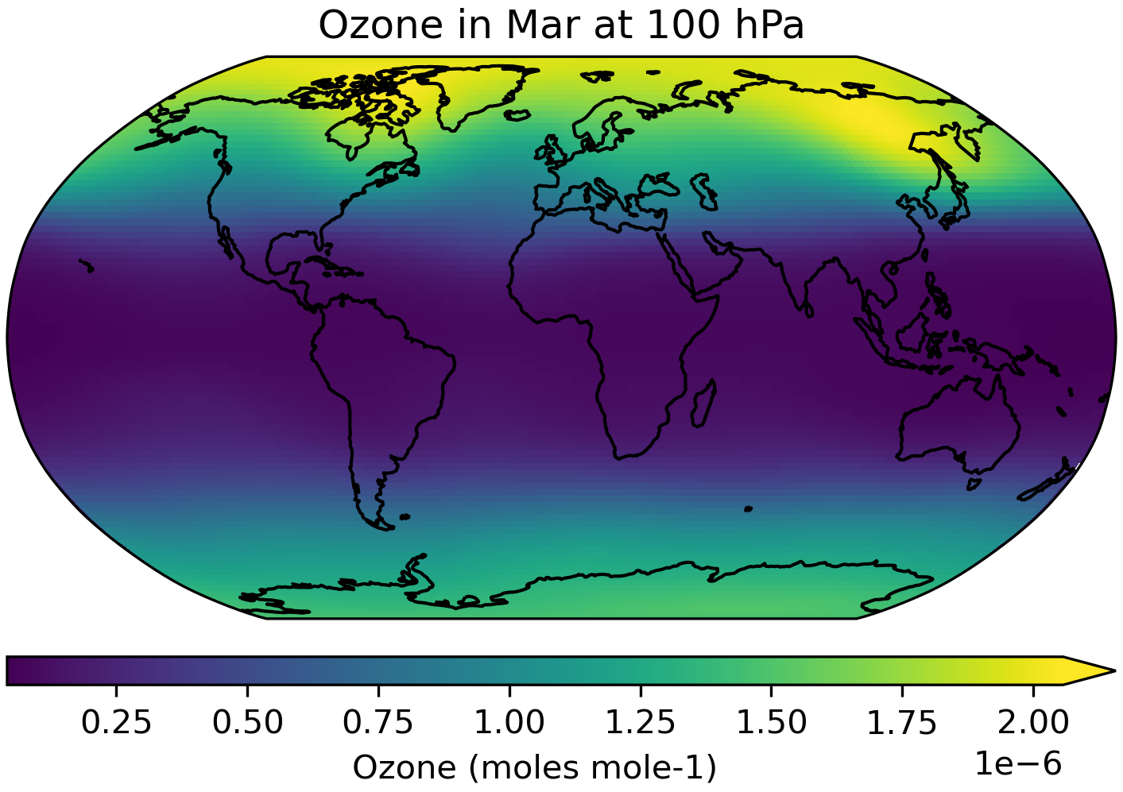
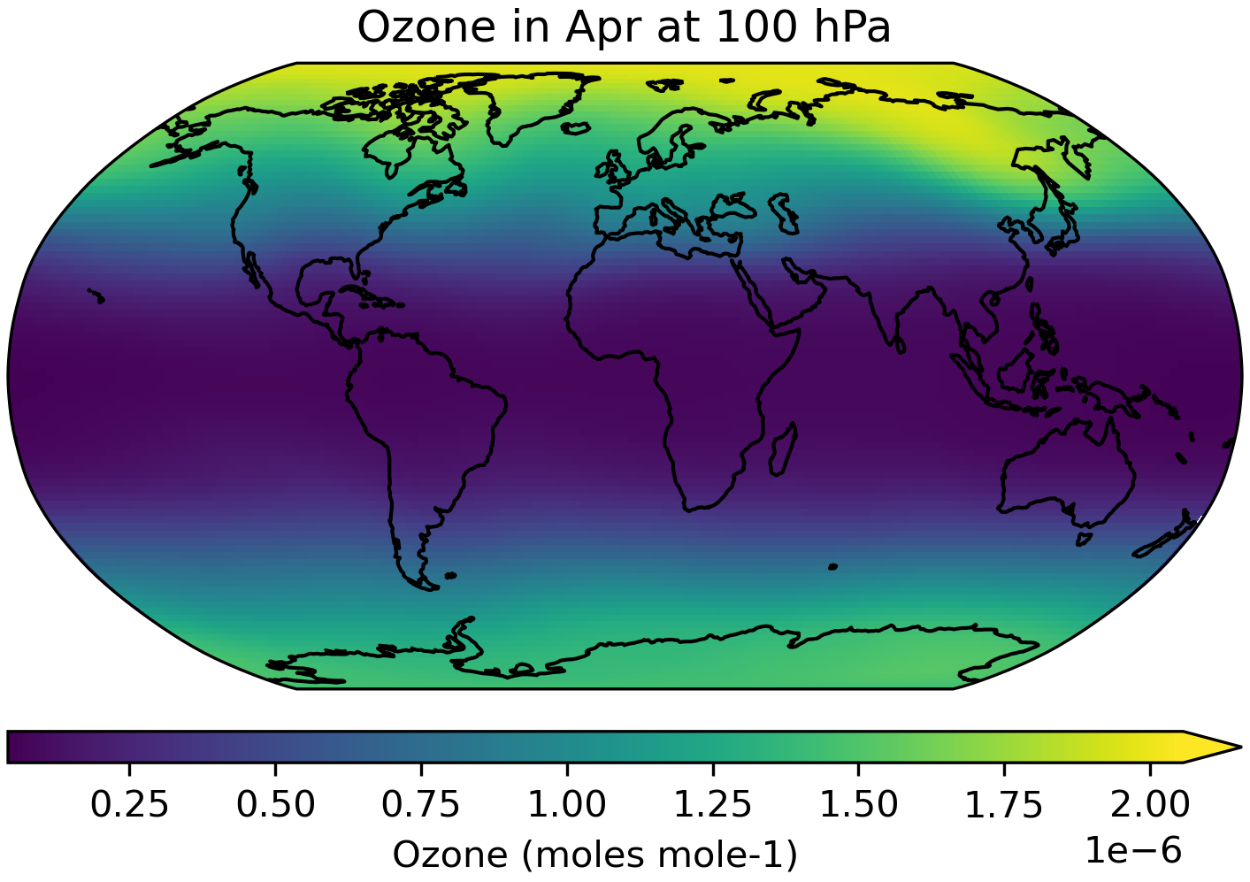
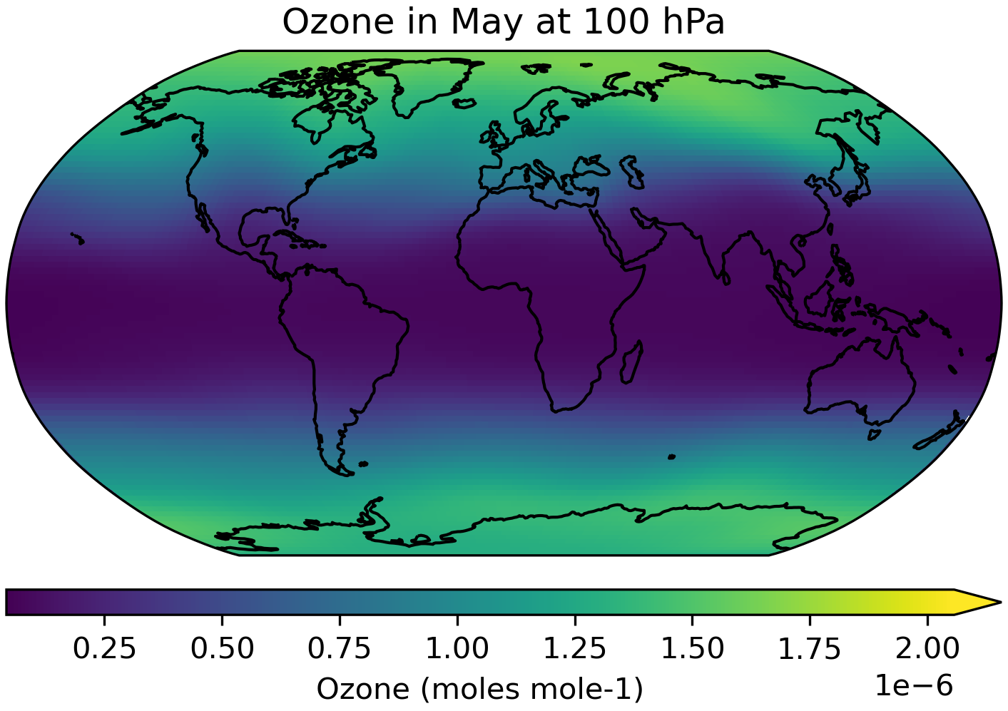
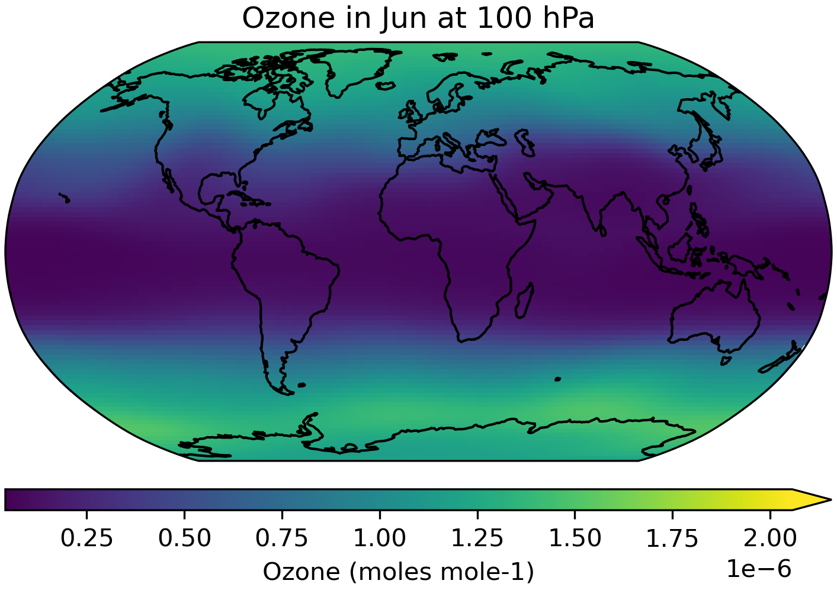
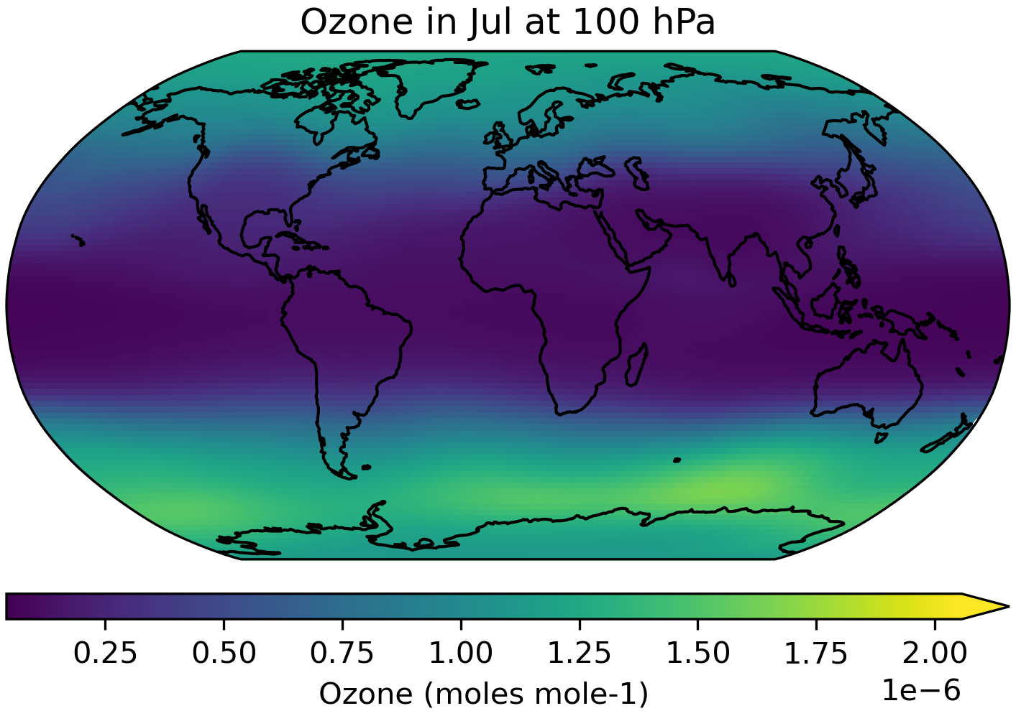
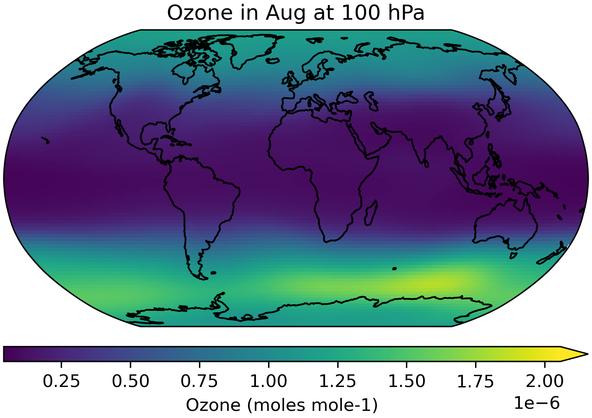
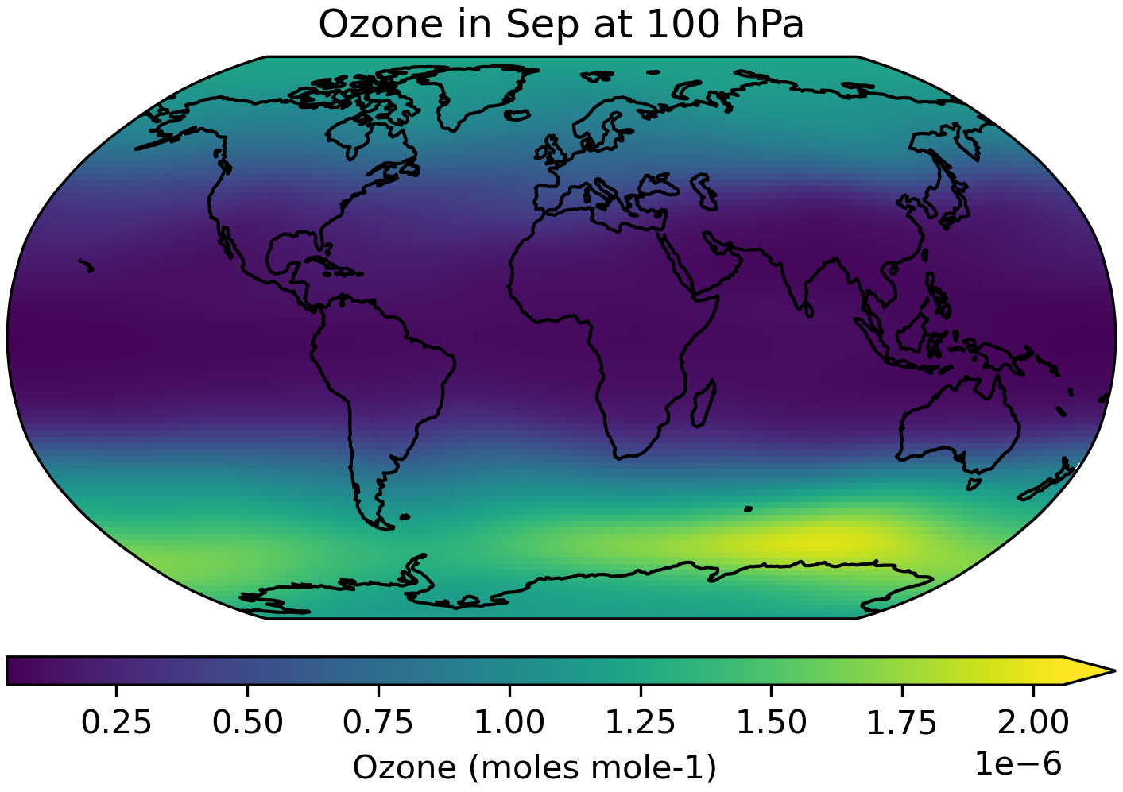
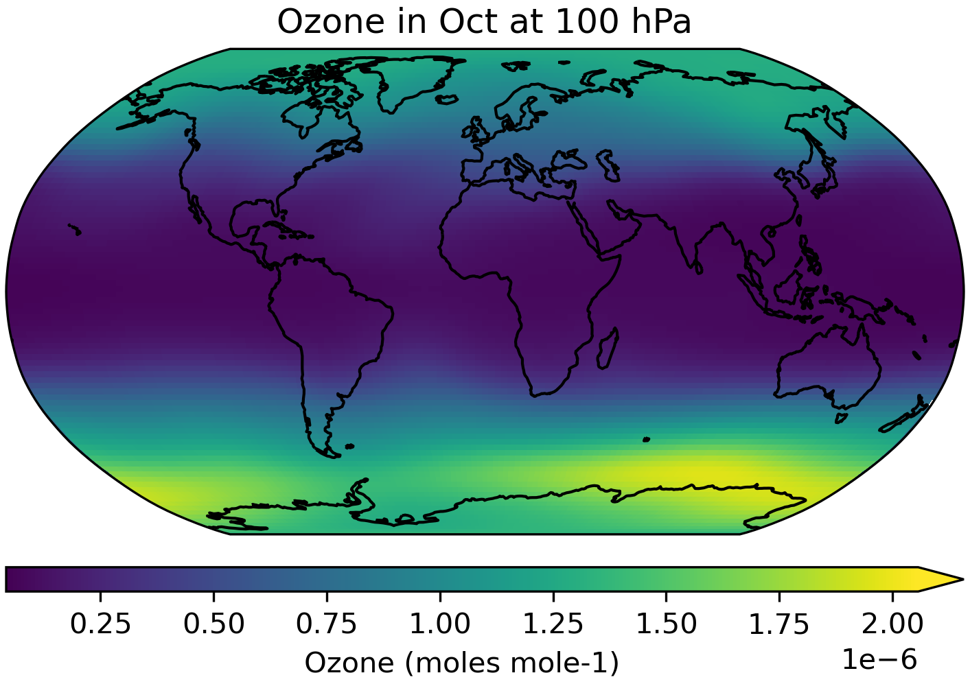
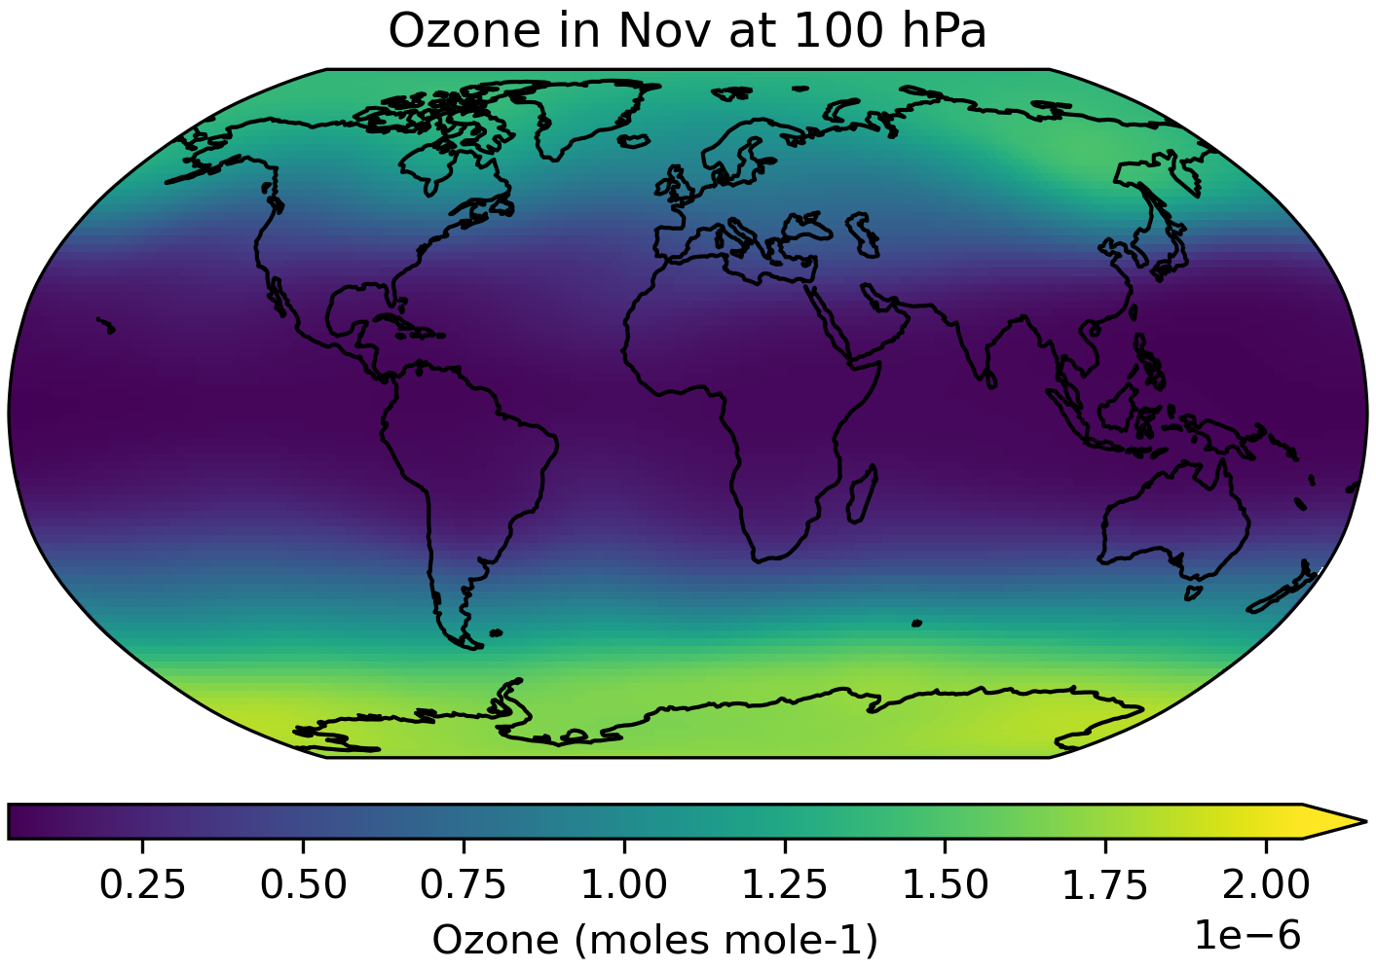
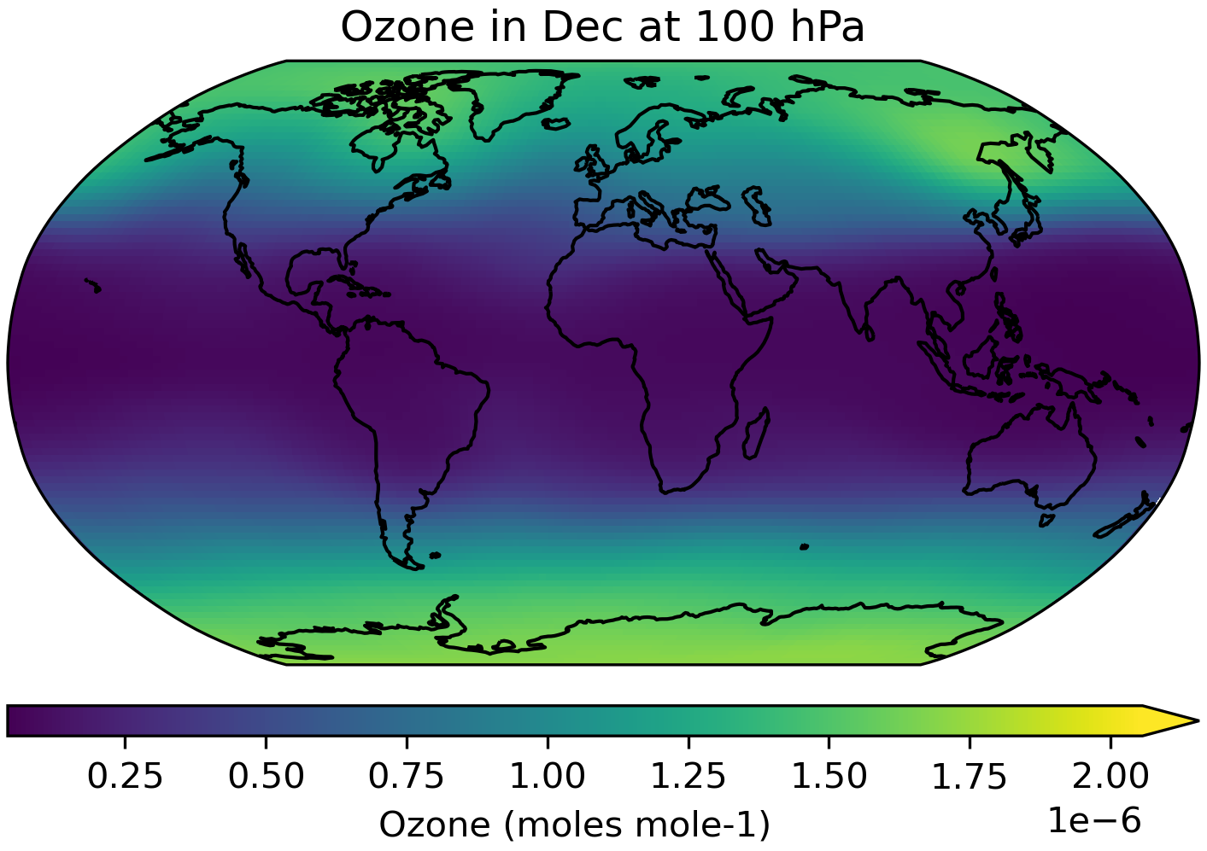
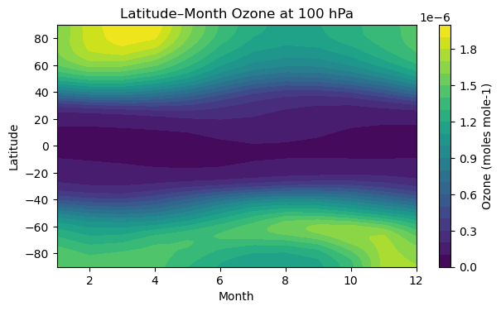
piControl climatology, 1850, 100 hPa
Original resolution

Slide 5
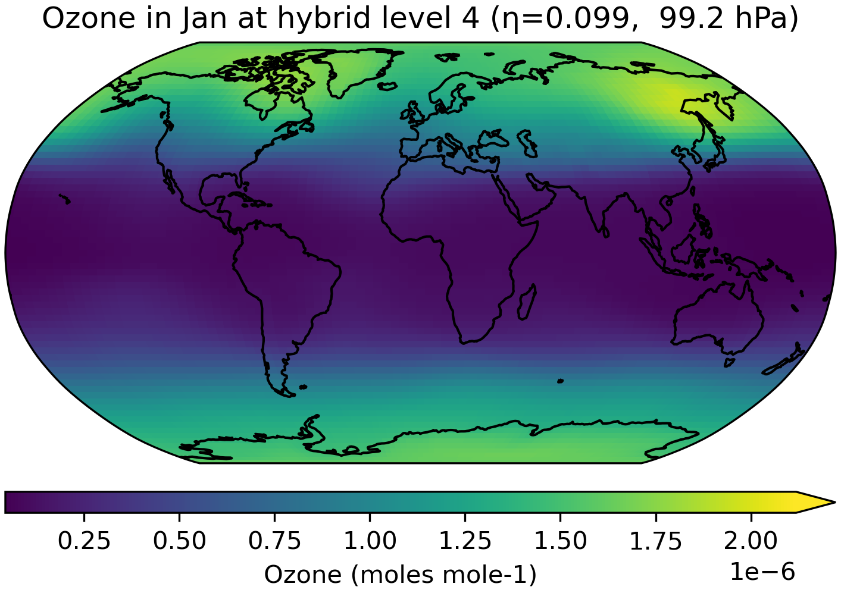
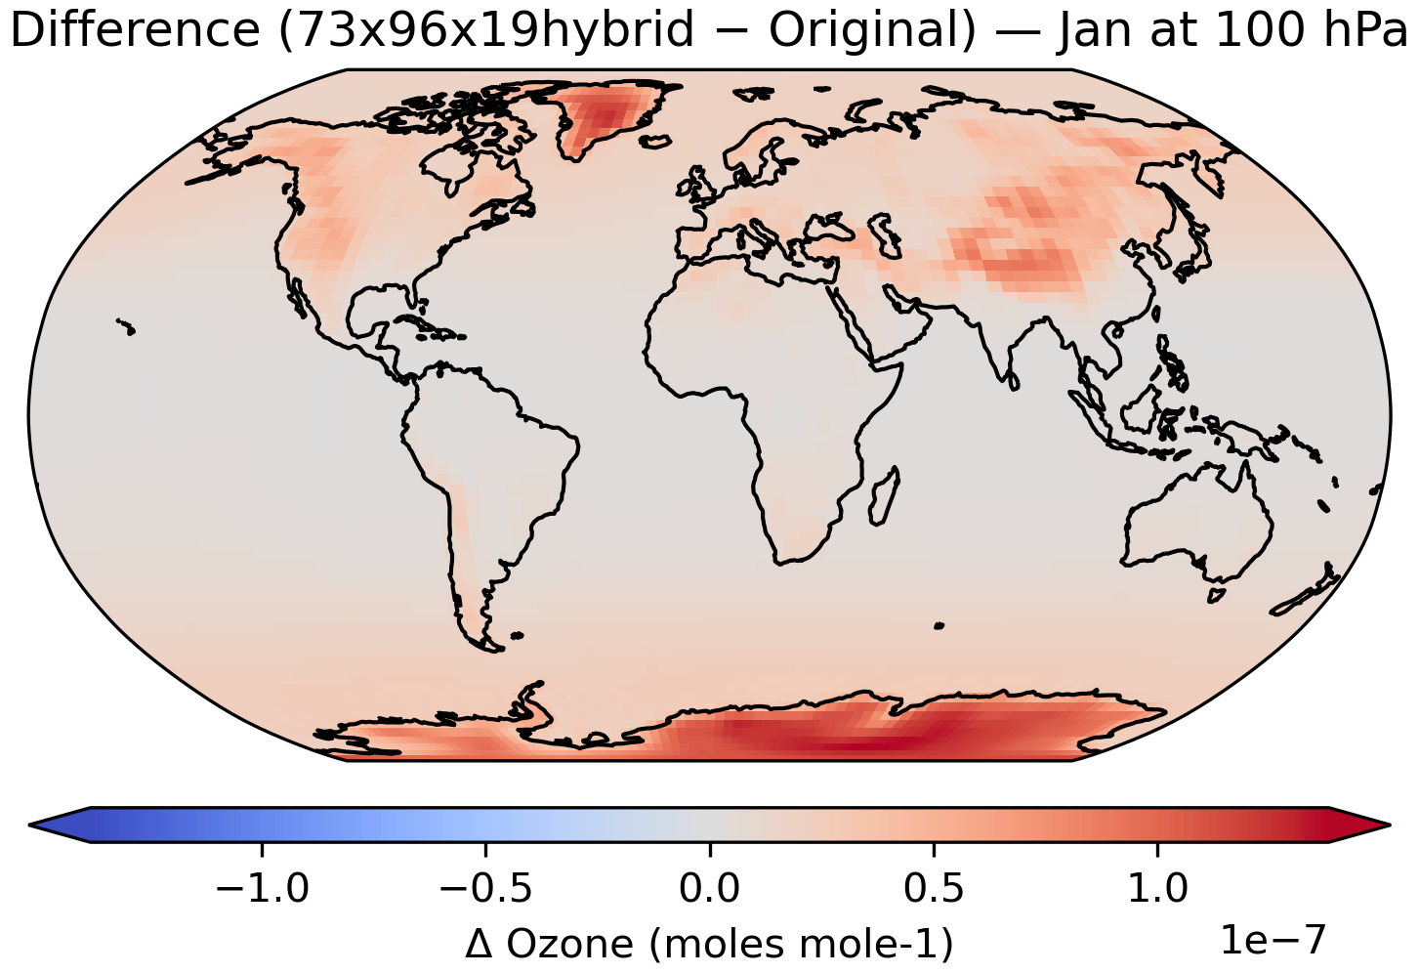
piControl climatology, 1850.01, ~100hPa
Original resolution
N48 x 19 hybrid

Slide 6
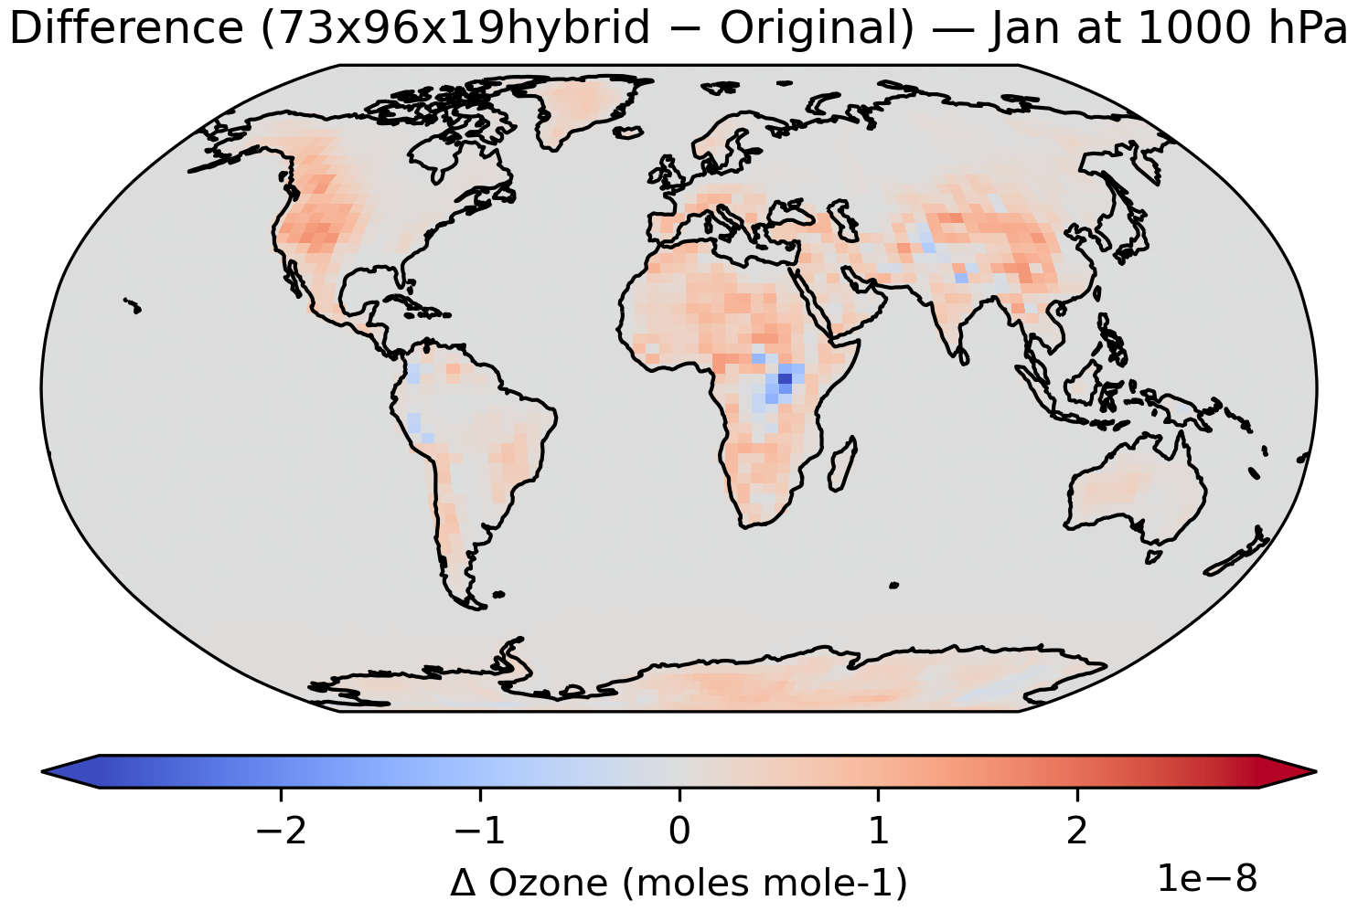
piControl climatology, 1850.01, ~1000hPa

Slide 7
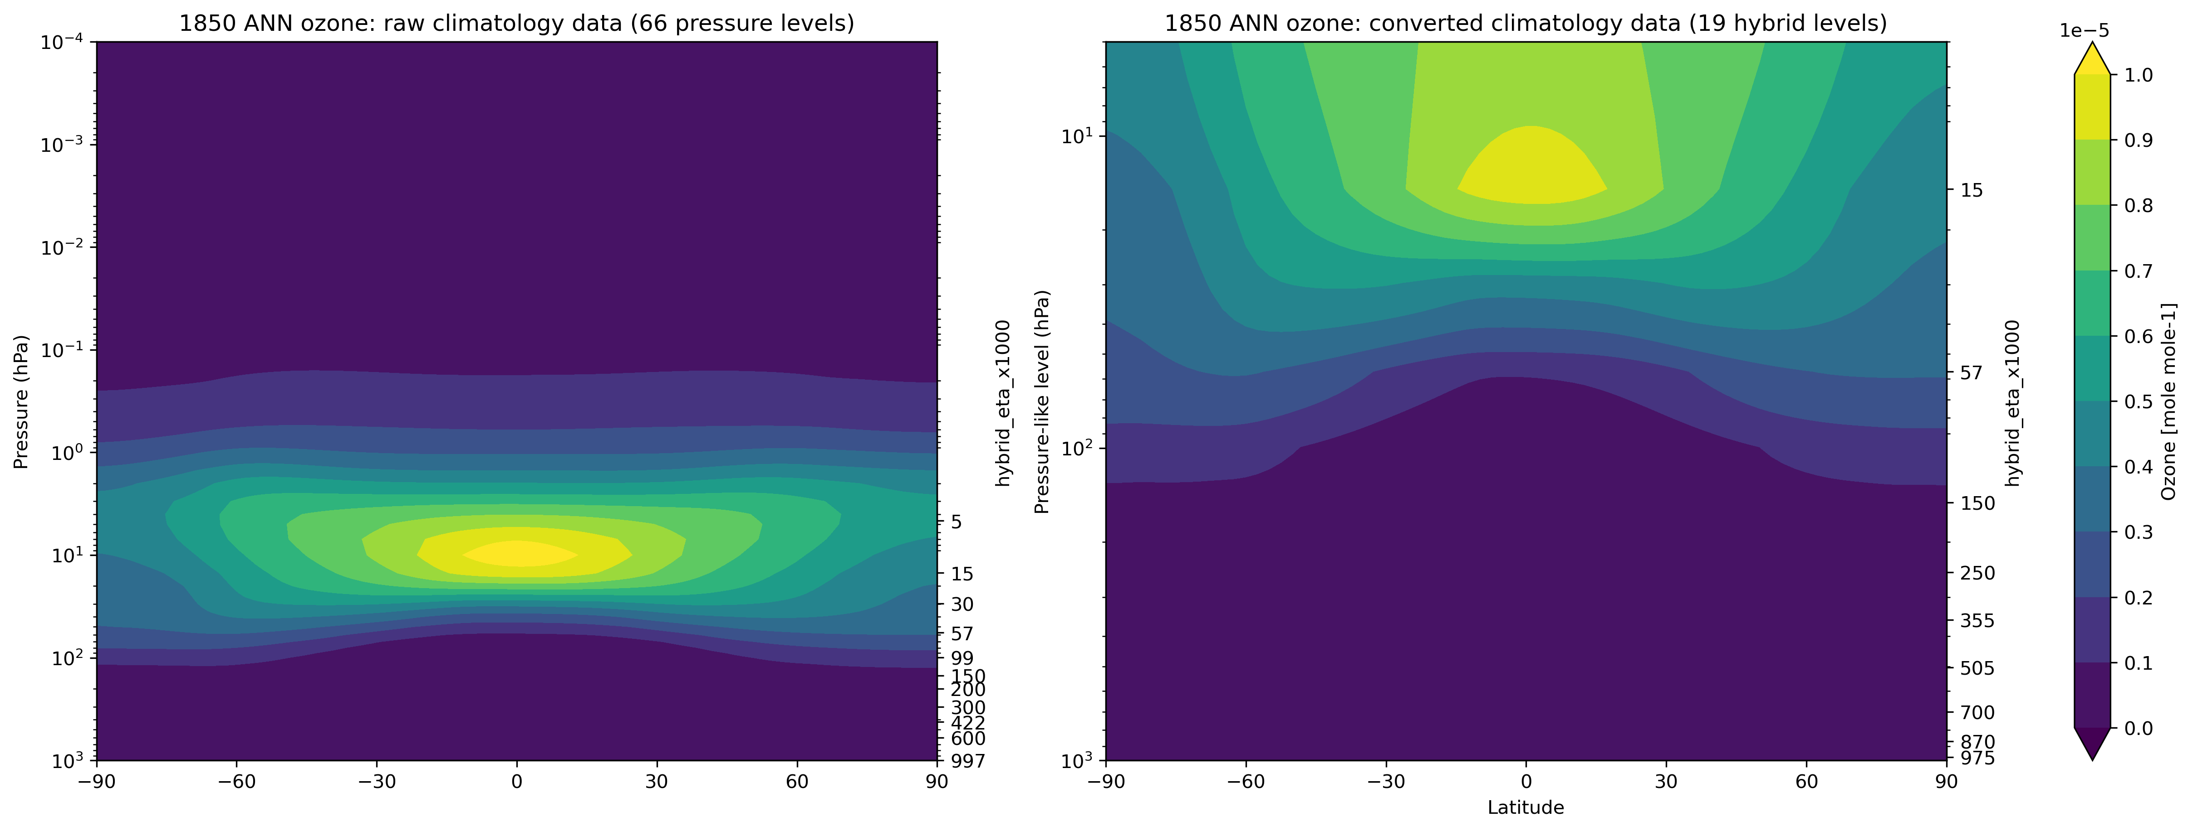
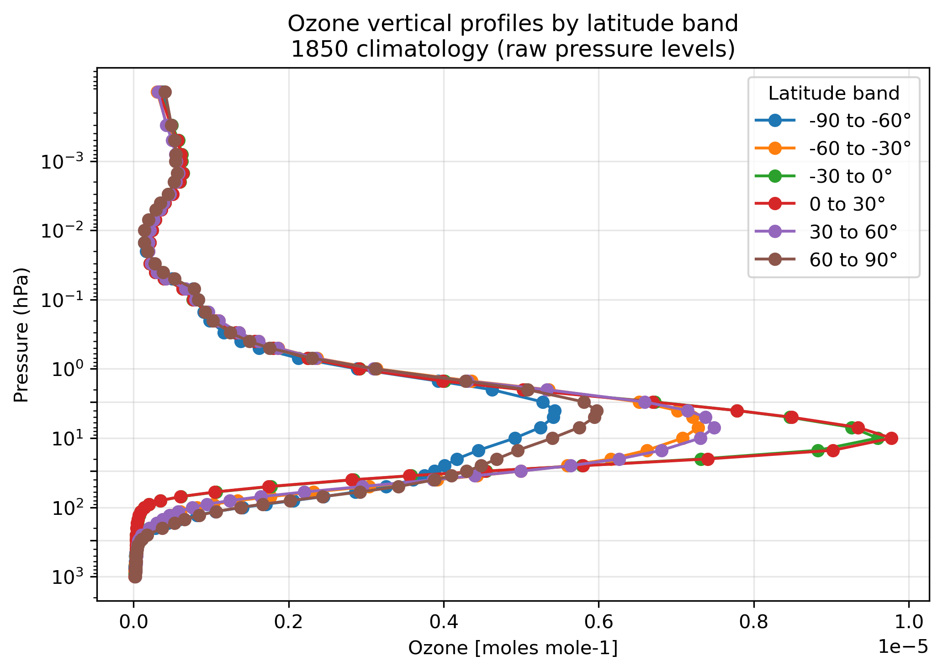
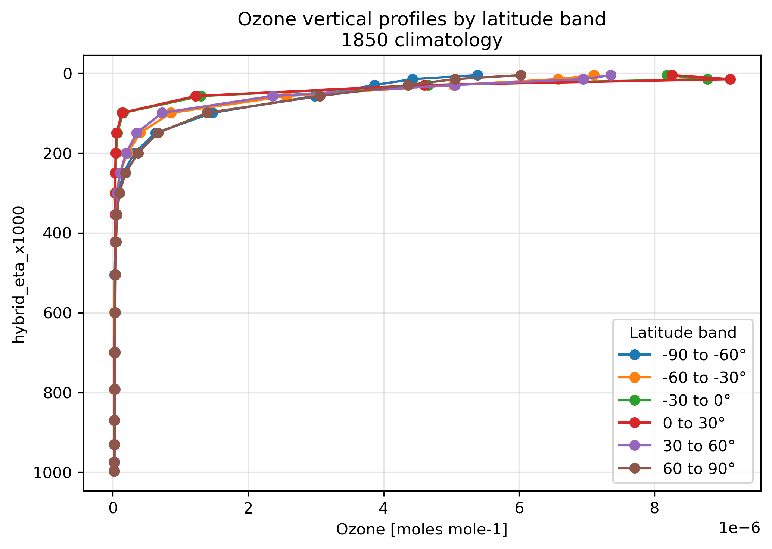
piControl 1850 annual mean
Original resolution
N48 x 19 hybrid
climatology data
remove variability
such as QBO signal
stratosphere
troposphere
troposphere

Slide 8
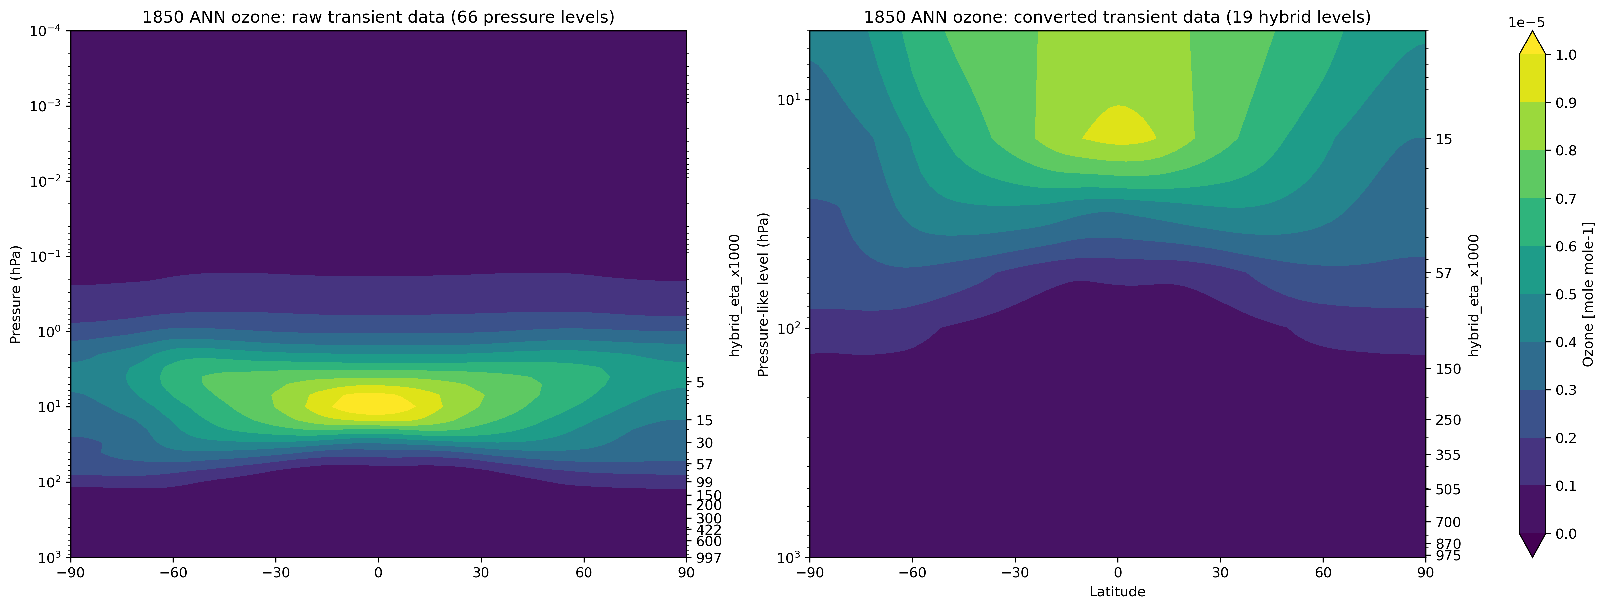
piControl 1850 annual mean
Original resolution
N48 x 19 hybrid
climatology data
remove variability
such as QBO signal
transient data
include nudged QBO signal

Slide 9
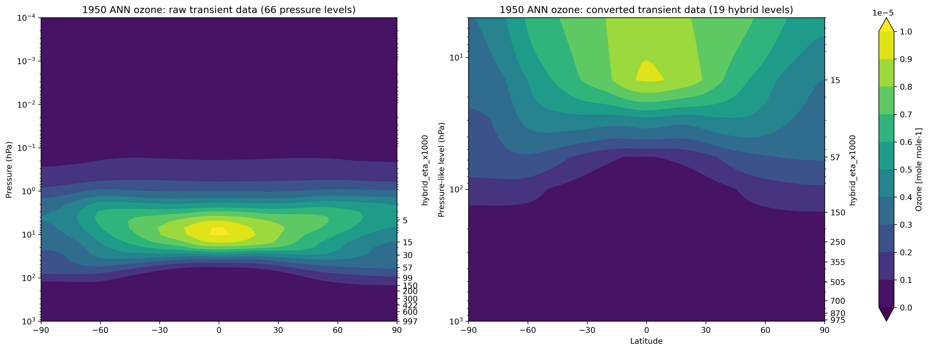
Historical transient 1950 annual mean
Original resolution
N48 x 19 hybrid
transient data
include nudged QBO signal

Slide 10
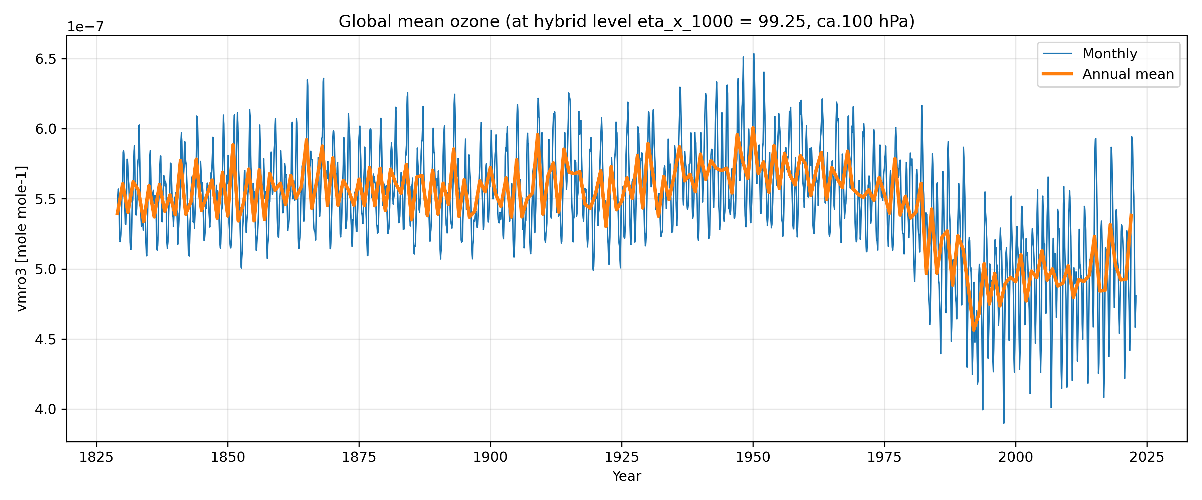
182901-202212 transient
Global mean, N48, hybrid levels

Slide 11
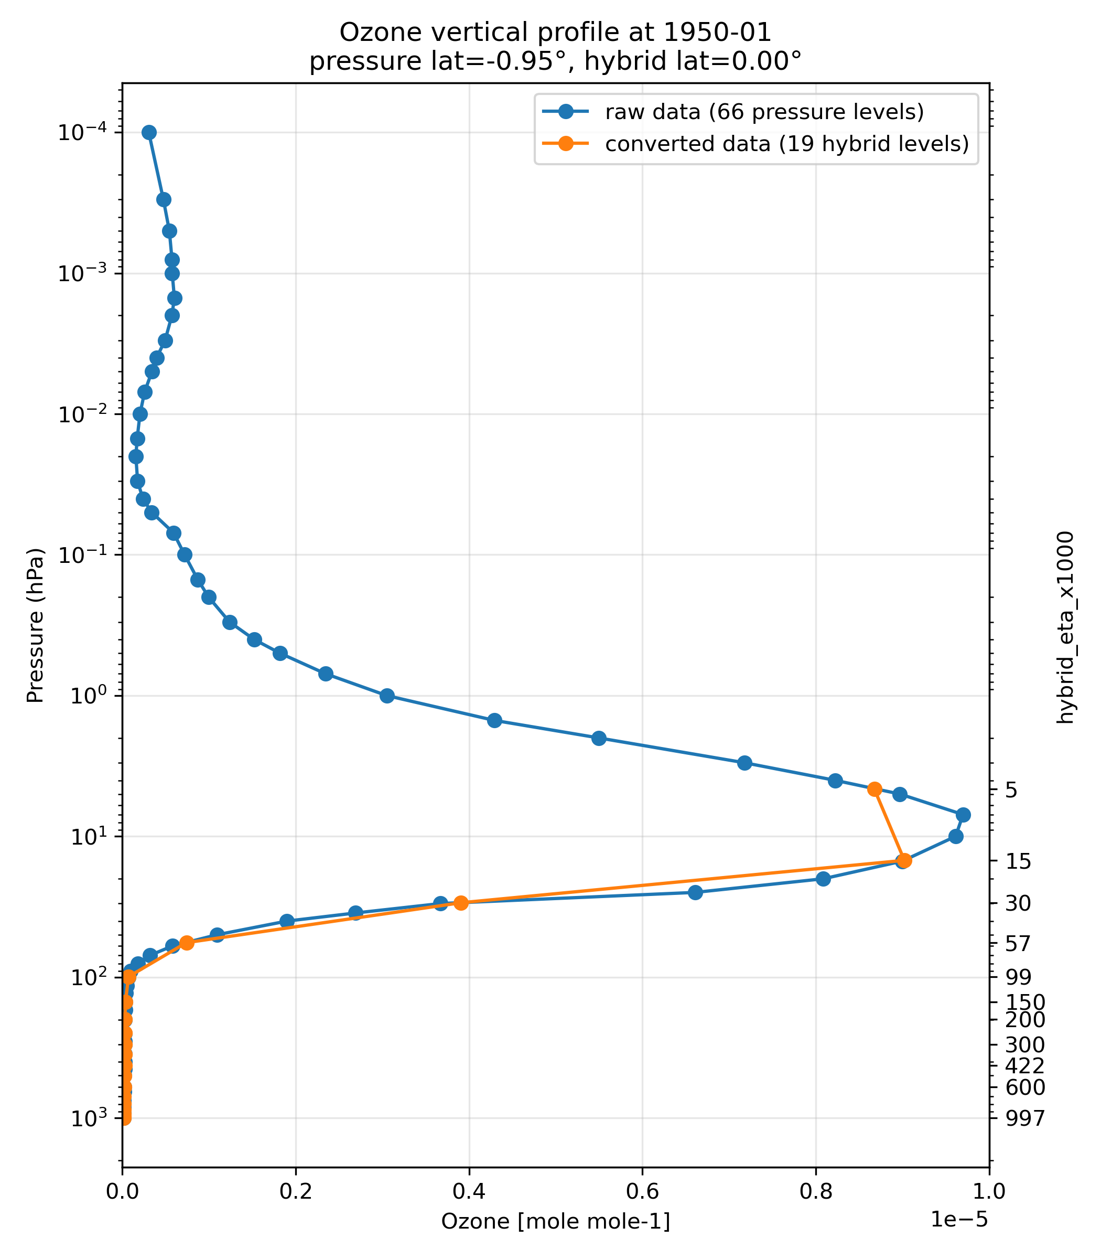
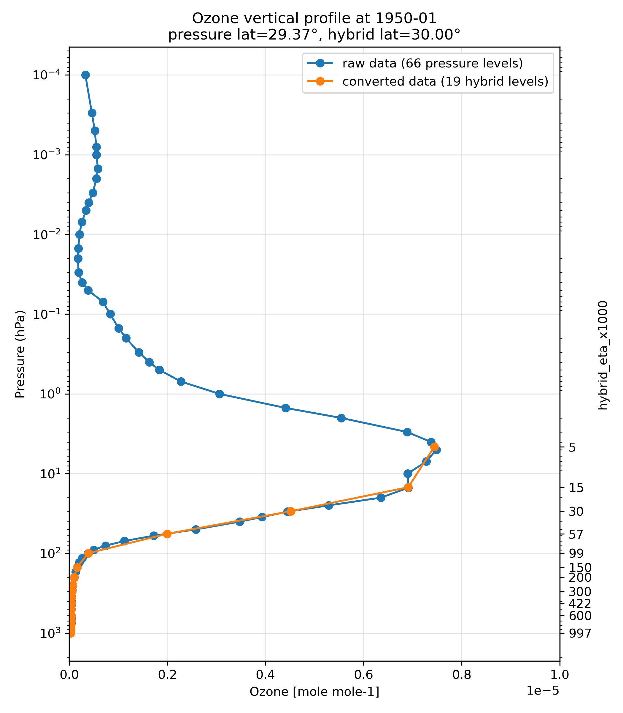
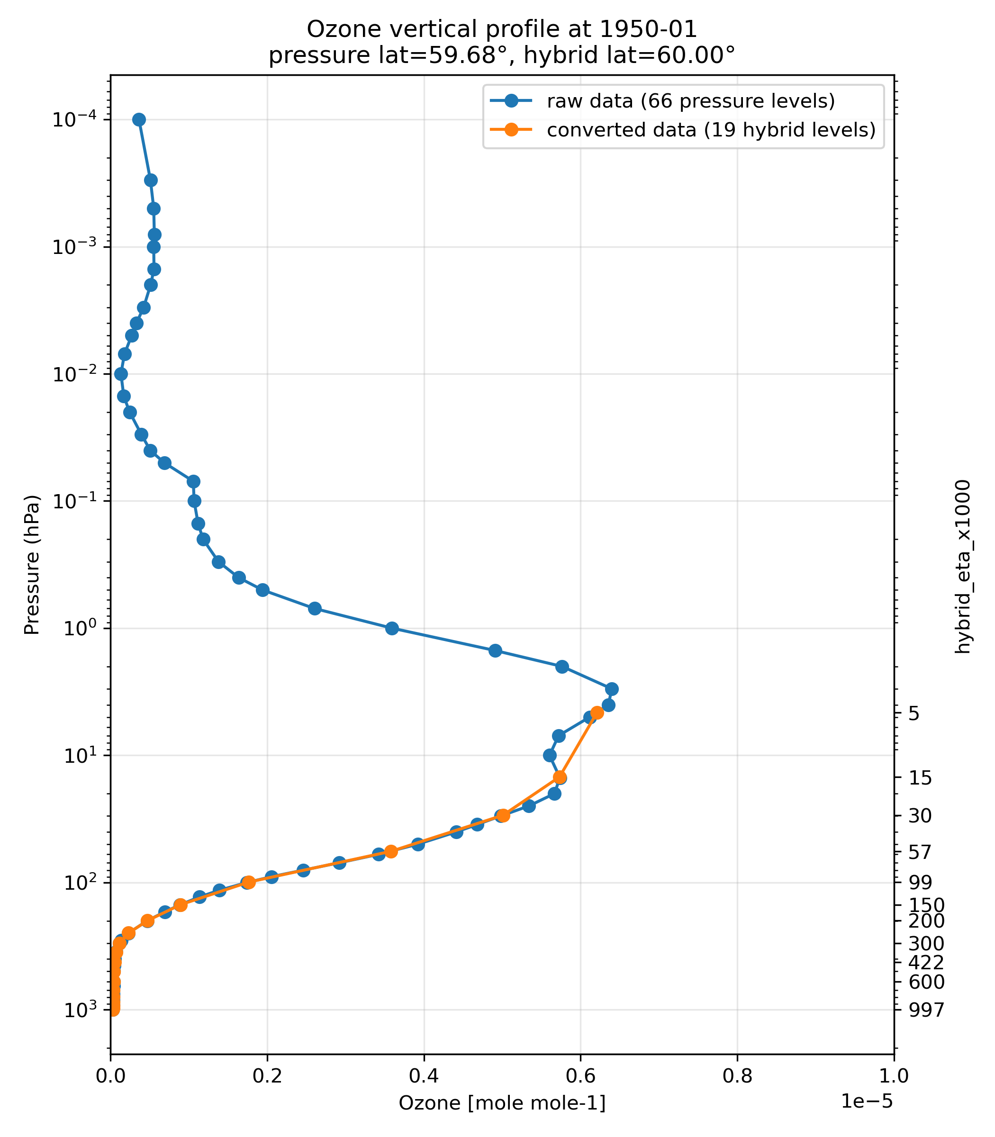
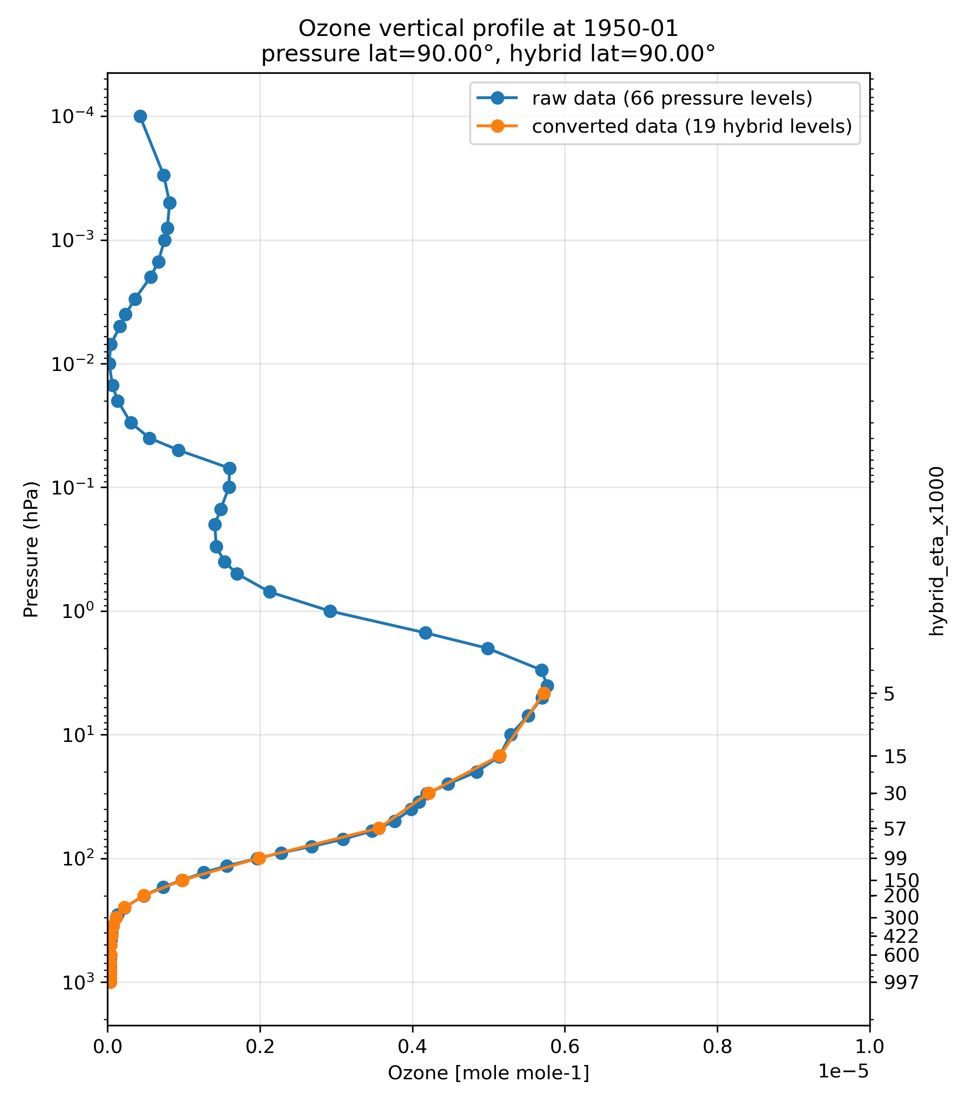
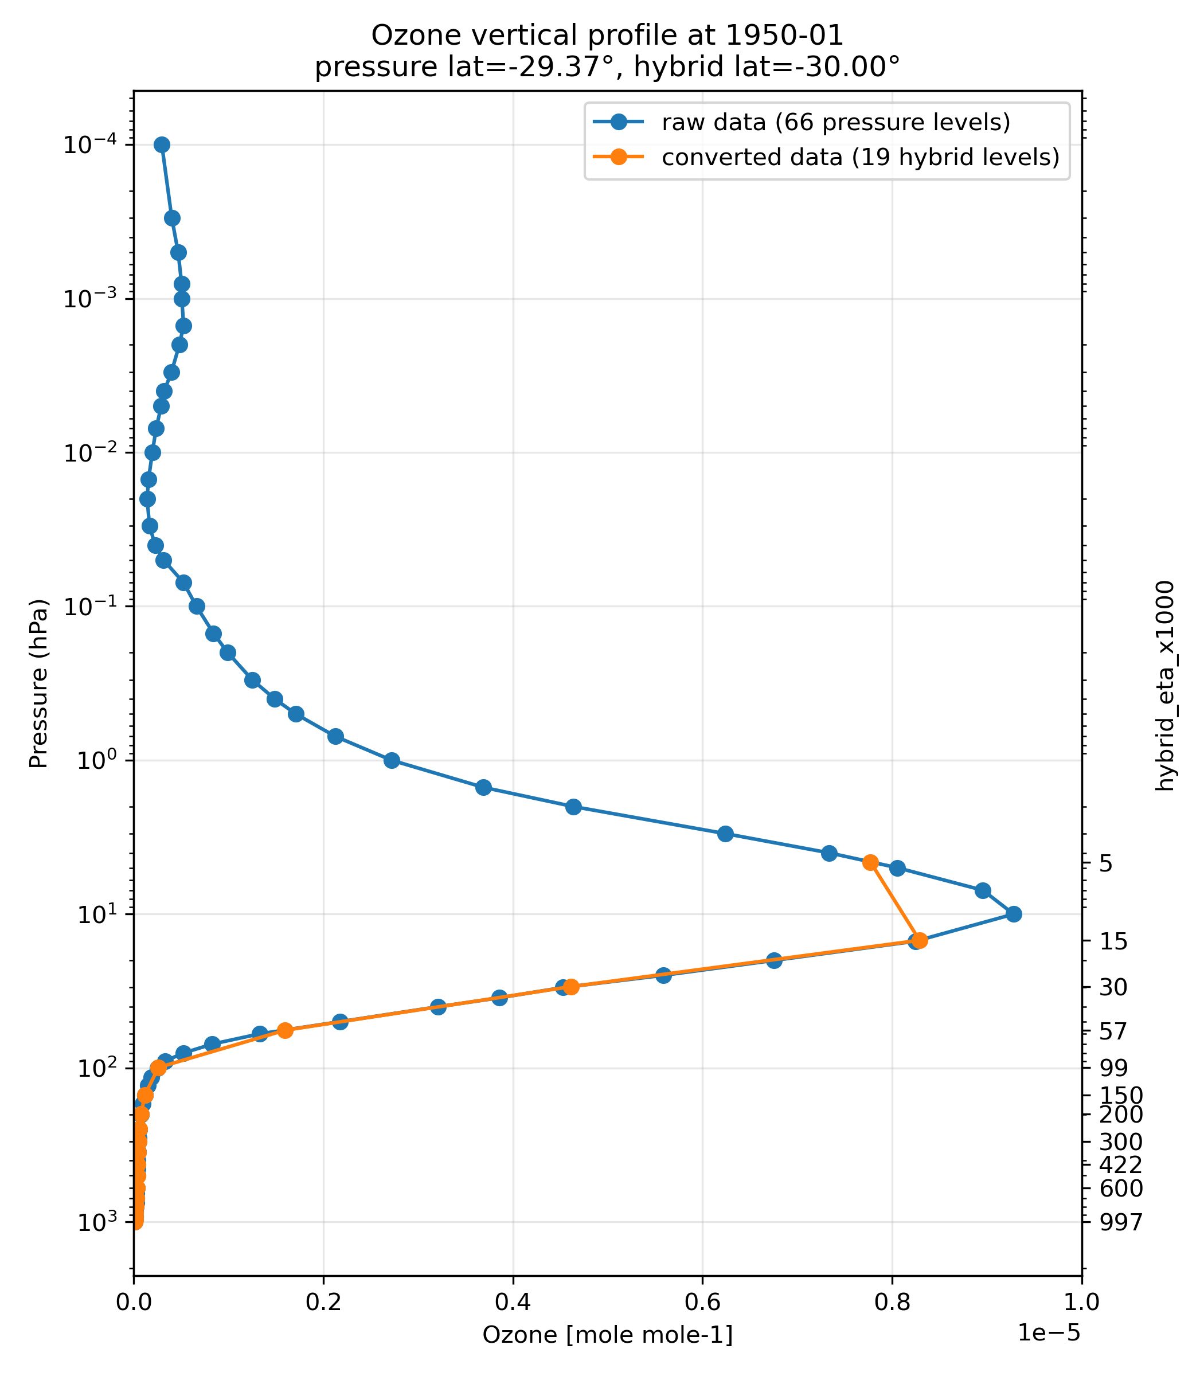
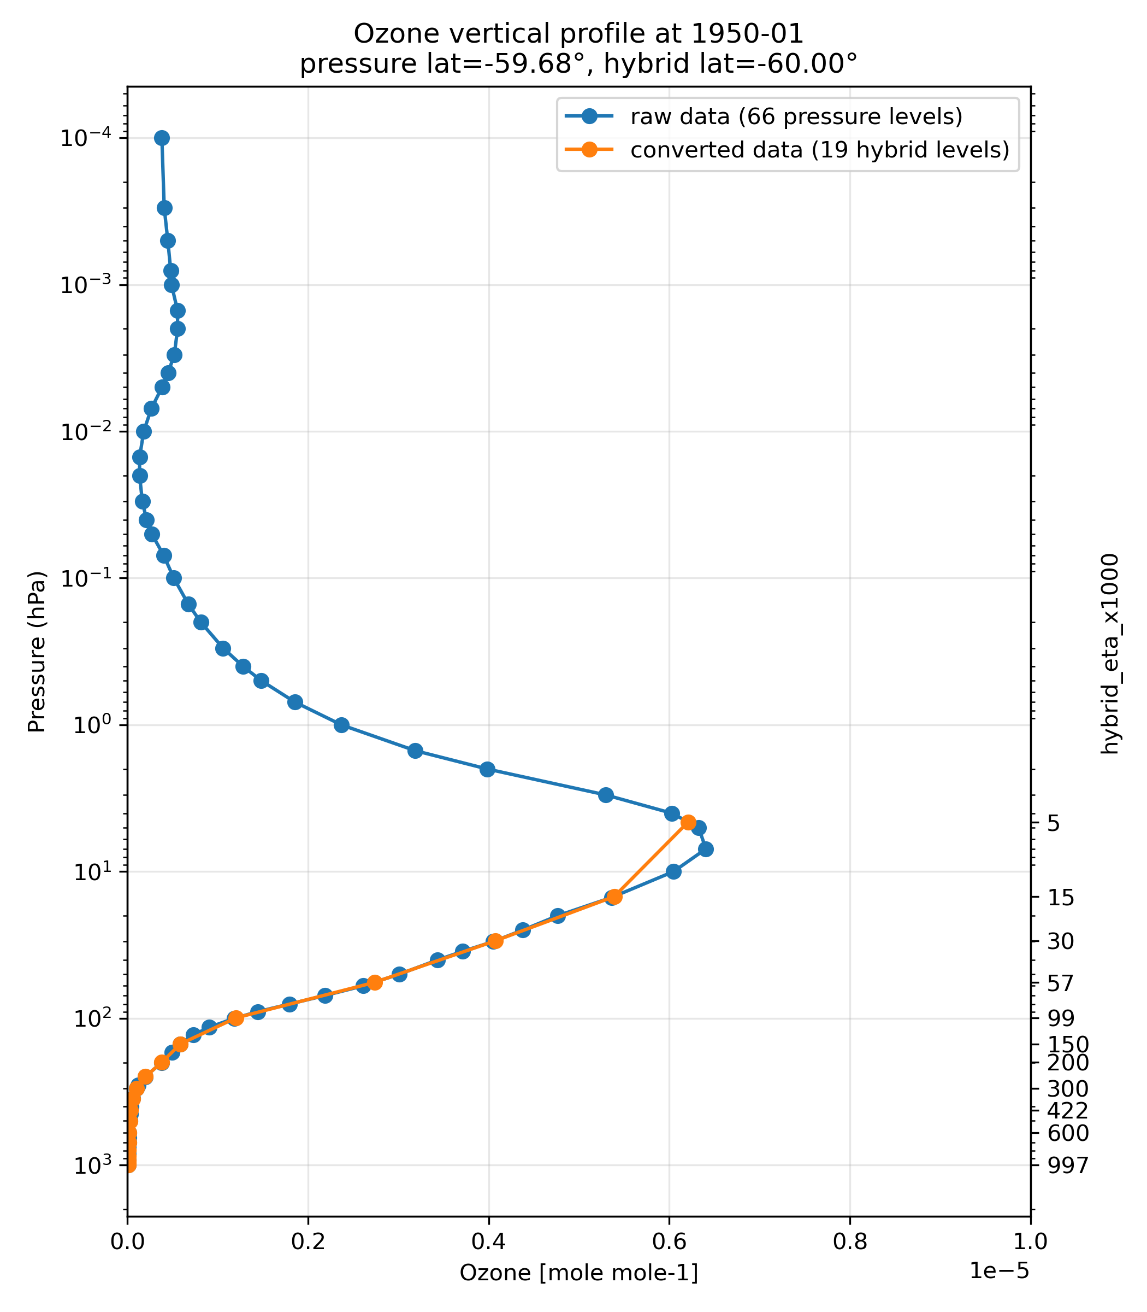
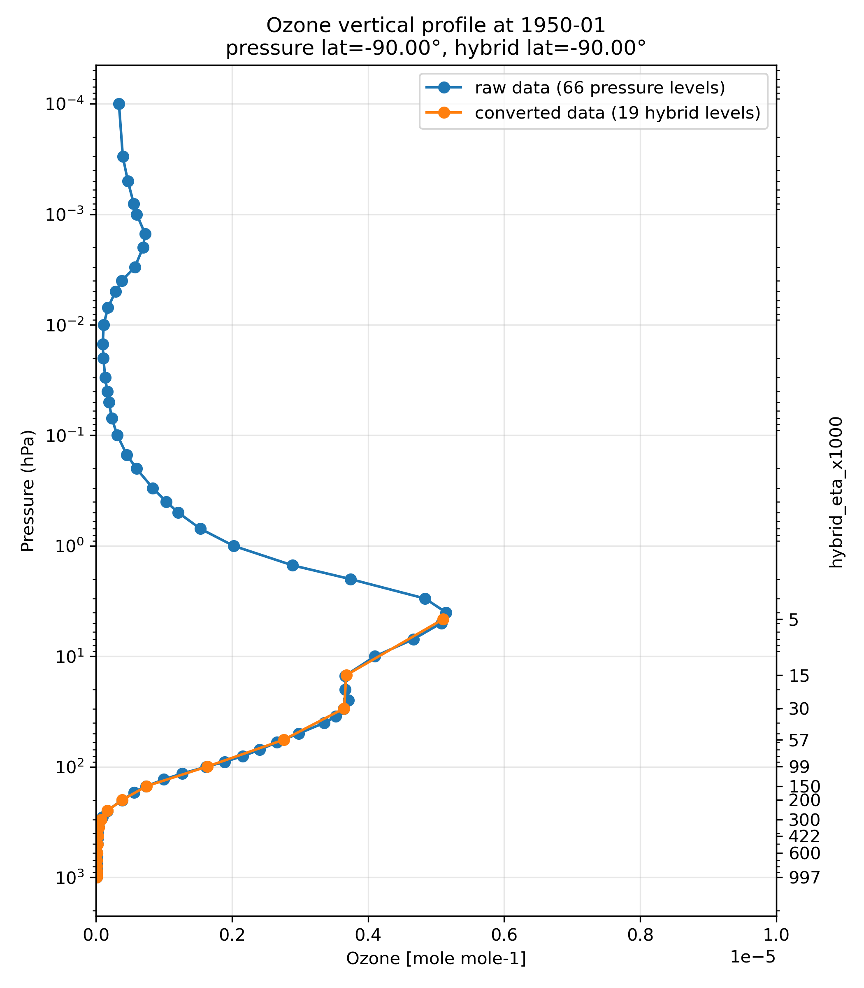
Vertical profile at 1950.01
Lat=0°
Lat=30°N
Lat=60°N
Lat=90°N
Lat=30°S
Lat=60°S
Lat=90°S

